Slide 1
Company Updates
SMS:
<news headline>
<news URL>
via GageIn at www.gagein.com

Slide 2
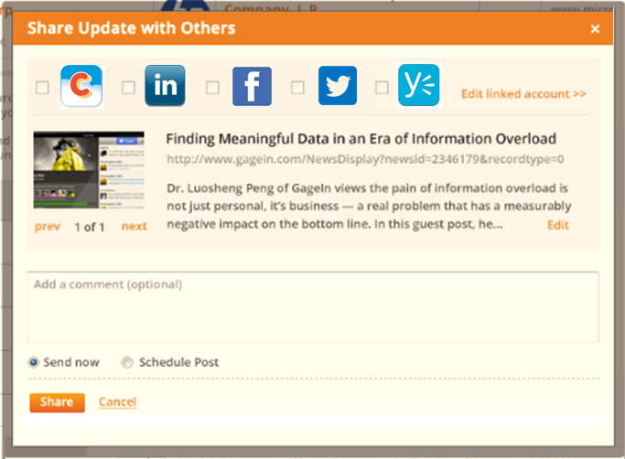
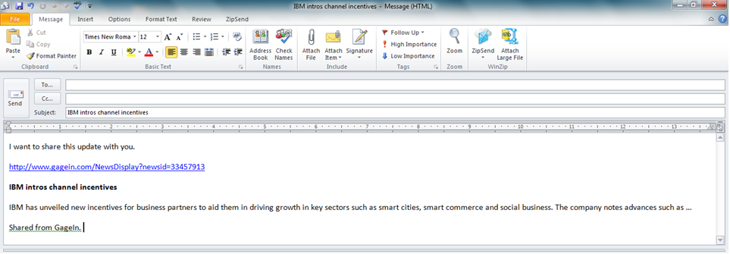
Shared from GageIn, a visual sales intelligence company.

Slide 3
Happenings
SMS:
<text>
via GageIn at www.gagein.com

Slide 4

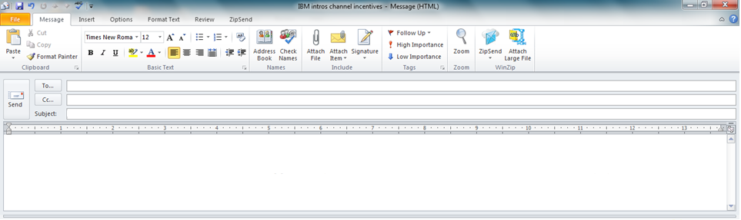
Revenue increases/decreases
Share
Hewlett Packard’s quarterly revenue has increased 5.34%.
Shared from GageIn.
Email
Hewlett Packard quarterly revenue
I want to share this update with you.
Hewlett Packard’s quarterly revenue has increased 5.34%.
Shared from GageIn, a visual sales intelligence company.

Slide 5
New headquarter address
Share
Hewlett Packard has a new address: 1234 Wolfe Rd, Cupertino, CA 99999.
Shared from GageIn.
Email
Hewlett Packard’s new headquarter
I want to share this update with you.
Hewlett Packard has a new address: 1234 Wolfe Rd, Cupertino, CA 99999.
Shared from GageIn, a visual sales intelligence company.

Slide 6
Employees increase/decrease
Share
The employee size at Hewlett Packard has decreased to 38,297.
Shared from GageIn.
Email
Hewlett Packard’s number of employees
I want to share this update with you.
The employee size at Hewlett Packard has decreased to 38,297.
Shared from GageIn, a visual sales intelligence company.

Slide 7
Employees join another company
Share
Ganesh Kumaraswamy, CFO at E2Open, has joined Hewlett Packard as VP Finance.
Shared from GageIn.
Email
New manager joins Hewlett Packard
I want to share this update with you.
Ganesh Kumaraswamy, CFO at E2Open, has joined Hewlett Packard as VP Finance.
Shared from GageIn, a visual sales intelligence company.

Slide 8
Employees left company
Share
Ganesh Kumaraswamy, VP Finance, has left Hewlett Packard and is now CFO at E2Open.
Shared from GageIn.
Email
Manager departs from Hewlett Packard
I want to share this update with you.
Ganesh Kumaraswamy, VP Finance, has left Hewlett Packard and is now CFO at E2Open.
Shared from GageIn, a visual sales intelligence company.

Slide 9
Employees left company
Share
Ganesh Kumaraswamy, VP Finance, has left Hewlett Packard.
Shared from GageIn.
Email
Manager departs from Hewlett Packard
I want to share this update with you.
Ganesh Kumaraswamy, VP Finance, has left Hewlett Packard.
Shared from GageIn, a visual sales intelligence company.

Slide 10
Employees change job title
Share
Ganesh Kumaraswamy, VP Finance, is now CFO at Hewlett Packard.
Shared from GageIn.
Email
Position change at Hewlett Packard
I want to share this update with you.
Ganesh Kumaraswamy, VP Finance, is now CFO at Hewlett Packard..
Shared from GageIn, a visual sales intelligence company.

Slide 11
Close funding
Share
Hewlett Packard closed $3 Millions in B funding.
Shared from GageIn.
Email
Hewlett Packard’s new funding
I want to share this update with you.
Hewlett Packard closed $3 Millions in B funding.
Shared from GageIn, a visual sales intelligence company.

Slide 12
Close funding
Share
Hewlett Packard closed $3 Millions.
Shared from GageIn.
Email
Hewlett Packard’s new funding
I want to share this update with you.
Hewlett Packard closed $3 Millions.
Shared from GageIn, a visual sales intelligence company.

Slide 13
People Updates
SMS:
<text>
via GageIn at www.gagein.com

Slide 14
Join another company
Share
Ganesh Kumaraswamy, CFO at E2Open, has joined Hewlett Packard as VP Finance.
Shared from GageIn.
Email
Ganesh Kumaraswamy joins Hewlett Packard
I want to share this update with you.
Ganesh Kumaraswamy, CFO at E2Open, has joined Hewlett Packard as VP Finance.
Shared from GageIn, a visual sales intelligence company.

Slide 15
New job title
Share
Ganesh Kumaraswamy, VP Finance, is now CFO at Hewlett Packard.
Shared from GageIn.
Email
Ganesh Kumaraswamy has a new job title at Hewlett Packard
I want to share this update with you.
Ganesh Kumaraswamy, VP Finance, is now CFO at Hewlett Packard.
Shared from GageIn, a visual sales intelligence company.

Slide 16
New location
Share
Ganesh Kumaraswamy, CFO at Hewlett Packard, has moved from San Francisco Bay Area to New York City.
Shared from GageIn.
Email
Hewlett Packard’s Ganesh Kumaraswamy has a new location
I want to share this update with you.
Ganesh Kumaraswamy, CFO at Hewlett Packard, has moved from San Francisco Bay Area to New York City.
Shared from GageIn, a visual sales intelligence company.

Slide 17
New profile picture
Share
Ganesh Kumaraswamy, CFO at Hewlett Packard, has a new profile picture on LinkedIn: <new-profile-picture-URL>
Shared from GageIn.
Email
Hewlett Packard’s Ganesh Kumaraswamy has a new picture
I want to share this update with you.
Ganesh Kumaraswamy, CFO at Hewlett Packard, has a new profile picture on LinkedIn:
<new-profile-picture-URL>
Shared from GageIn, a visual sales intelligence company.

